Slide 1


Attribute Types

Slide 2


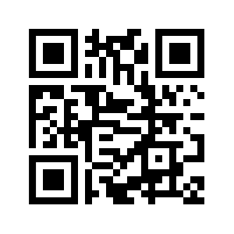



https://www.comixplain.cc
This comic was created as part of the Comixplain research project, funded by the University of Applied Sciences St. Pölten (USTP) through the Innovation Call 2022.
Project Team:
Victor-Adriel De-Jesus-Oliveira
Hsiang-Yun Wu
Christina Stoiber
Magdalena Boucher
Alena Boucher
Contact:
victor.oliveira@ustp.at
Illustrations: Magdalena Boucher & Alena Boucher
Attribute Types © 2025 by Comixplain Team (Victor-Adriel De-Jesus-Oliveira, Hsiang-Yun Wu, Christina Stoiber, Magdalena Boucher, and Alena Boucher) with illustrations by Magdalena Boucher and Alena Boucher, University of Applied Sciences St. Pölten (USTP), licensed under CC BY-SA 4.0

Slide 3
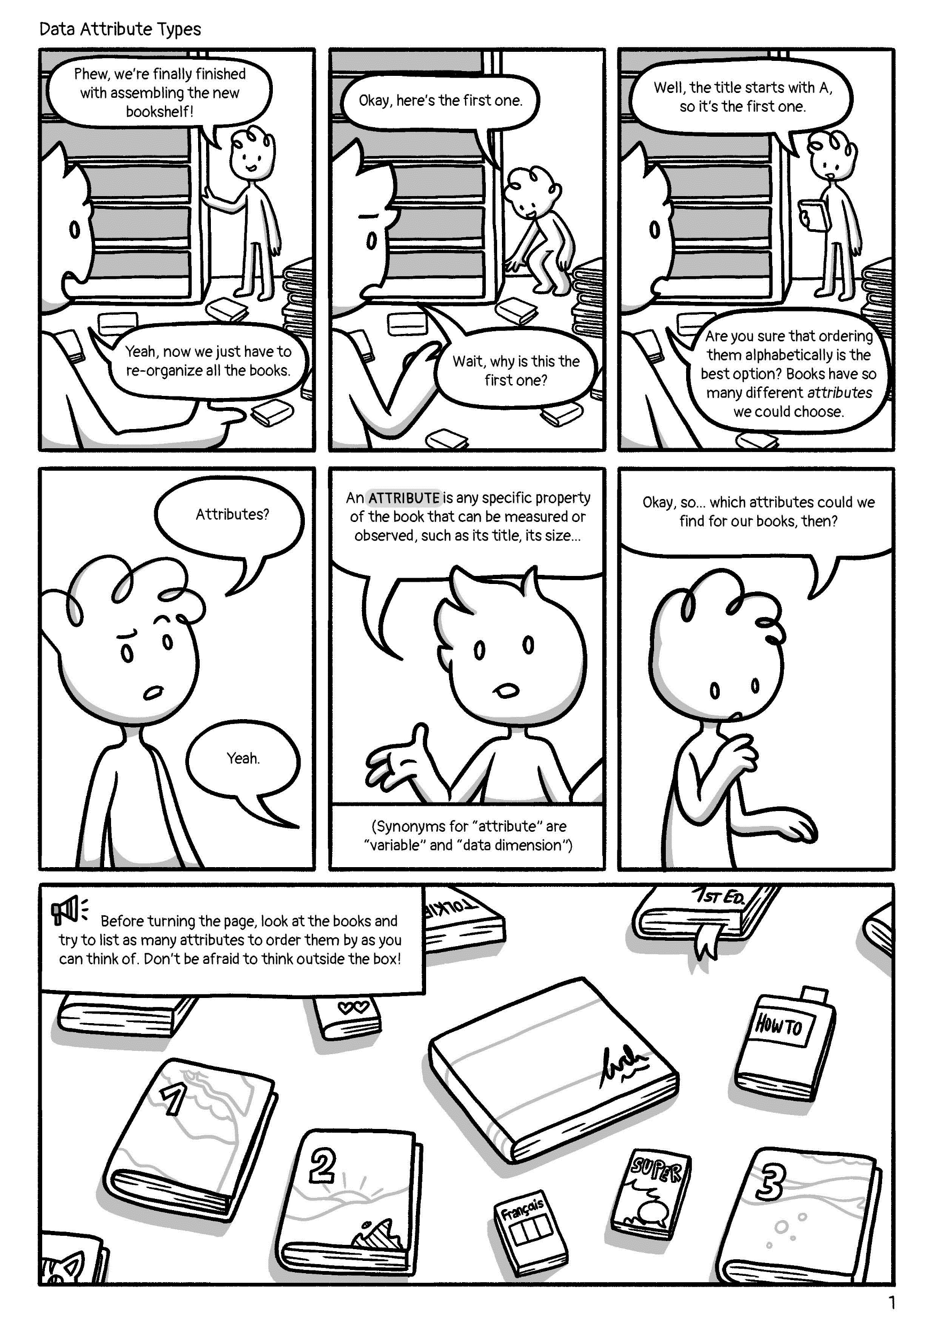
Attributes?
Phew, we‘re finally finished with assembling the new bookshelf!
Okay, here‘s the first one.
Well, the title starts with A, so it‘s the first one.
Yeah, now we just have to re-organize all the books.
Wait, why is this the first one?
Are you sure that ordering them alphabetically is the best option? Books have so many different attributes we could choose.
An ATTRIBUTE is any specific property of the book that can be measured or observed, such as its title, its size…
Okay, so… which attributes could we find for our books, then?
Yeah.
(Synonyms for “attribute“ are “variable“ and “data dimension“)
Before turning the page, look at the books and try to list as many attributes to order them by as you can think of. Don‘t be afraid to think outside the box!

Slide 4
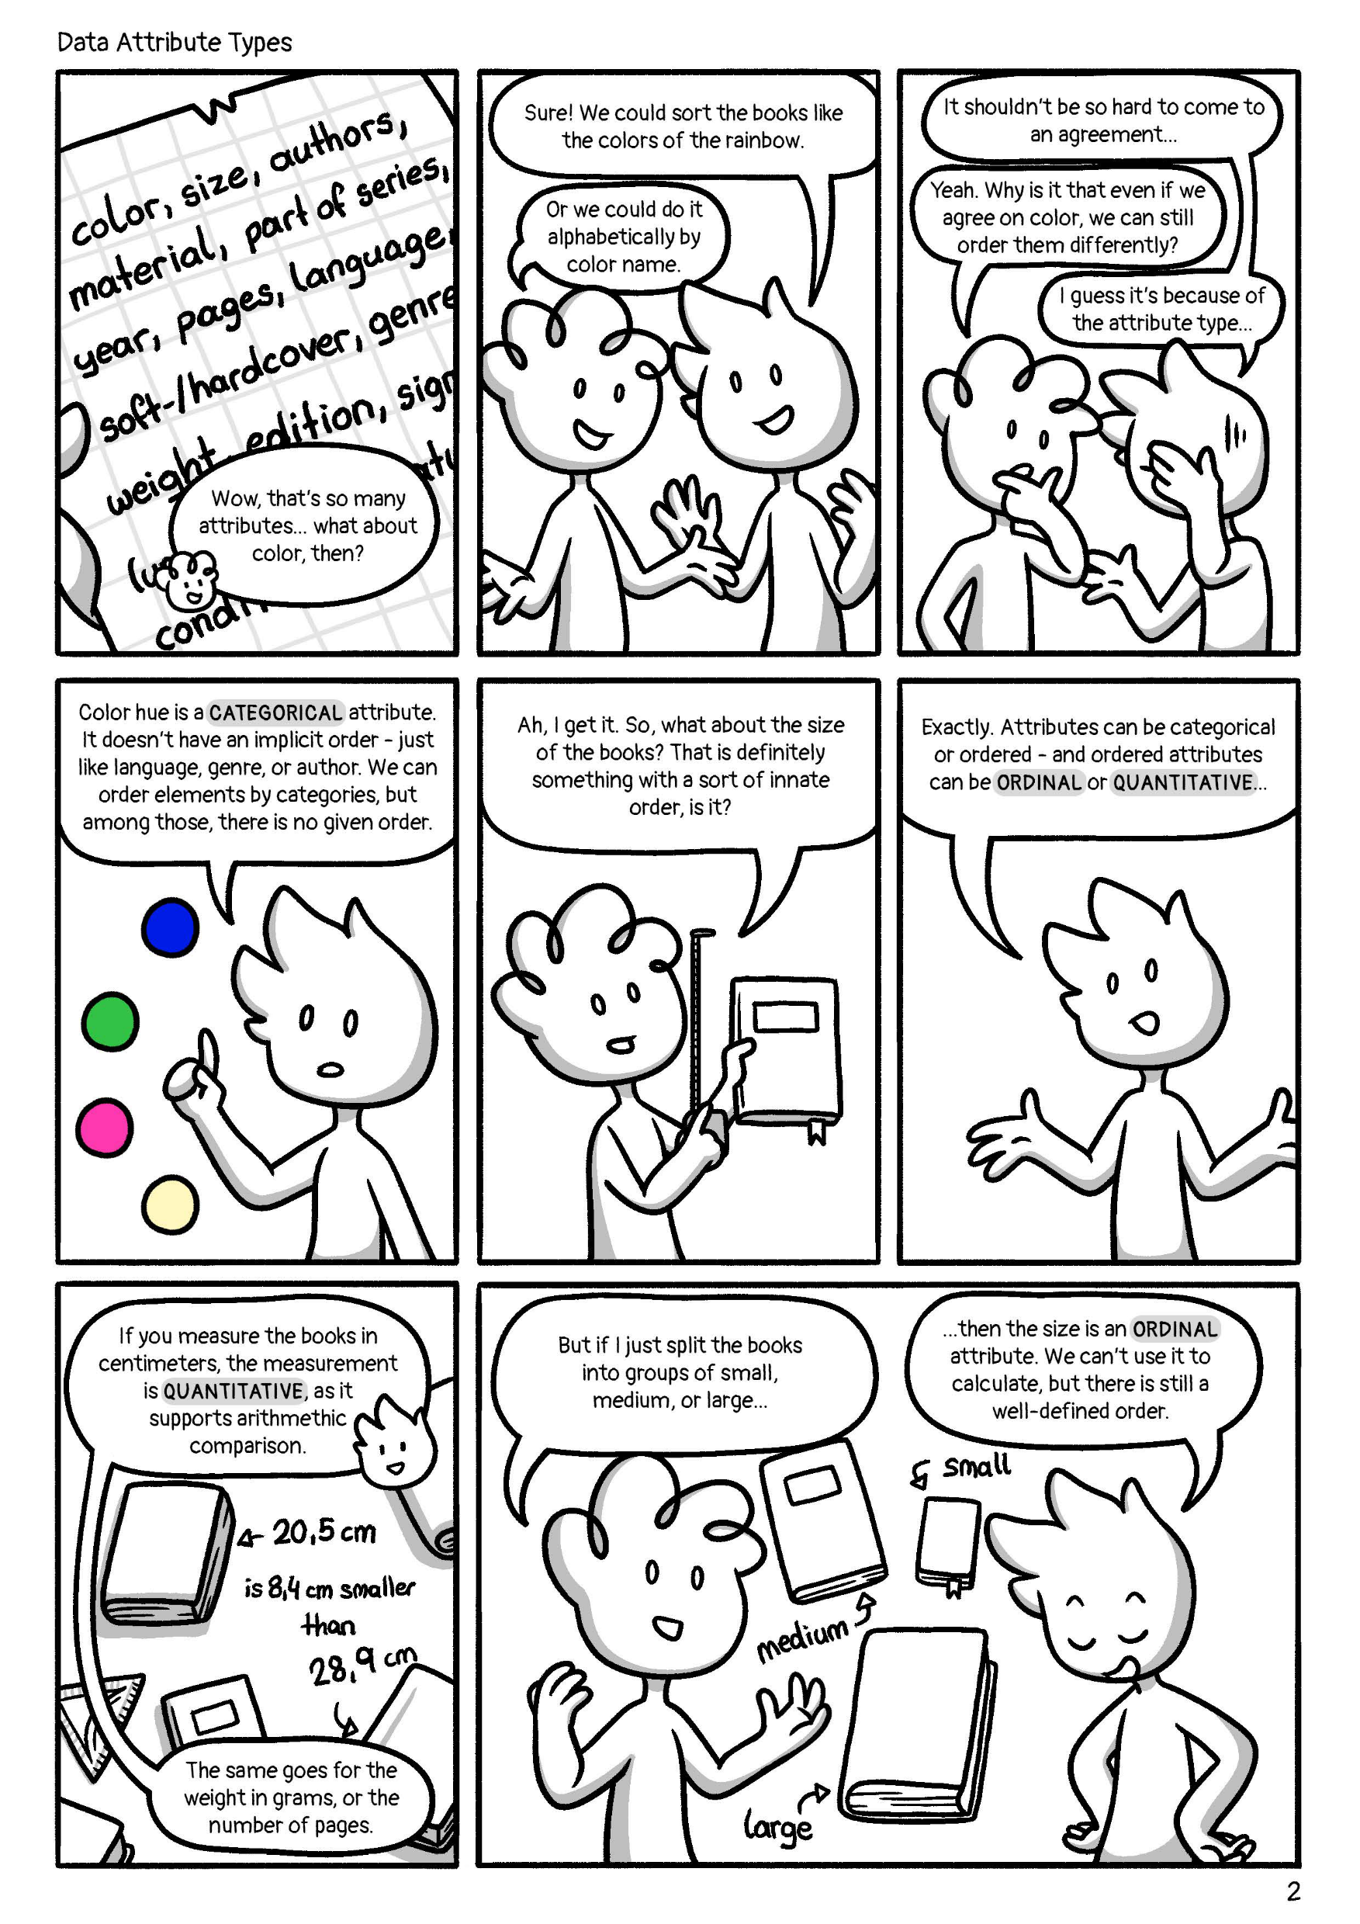
I guess it‘s because of the attribute type…
Sure! We could sort the books like the colors of the rainbow.
It shouldn‘t be so hard to come to an agreement…
Or we could do it alphabetically by color name
Yeah. Why is it that even if we agree on color, we can still order them differently?
Wow, that‘s so many attributes… what about color, then?
Color hue is a CATEGORICAL attribute. It doesn‘t have an implicit order – just like language, genre, or author. We can order elements by categories, but among those, there is no given order.
Ah, I get it. So, what about the size of the books? That is definitely something with a sort of innate order, is it?
Exactly. Attributes can be categorical or ordered – and ordered attributes can be ORDINAL or QUANTITATIVE…
If you measure the books in centimeters, the measurement is QUANTITATIVE, as it supports arithmethic comparison.
But if I just split the books into groups of small, medium, or large…
… then the size is an ORDINAL attribute. We can‘t use it to calculate, but there is still a well-defined order.
The same goes for the weight in grams, or the number of pages.

Slide 5
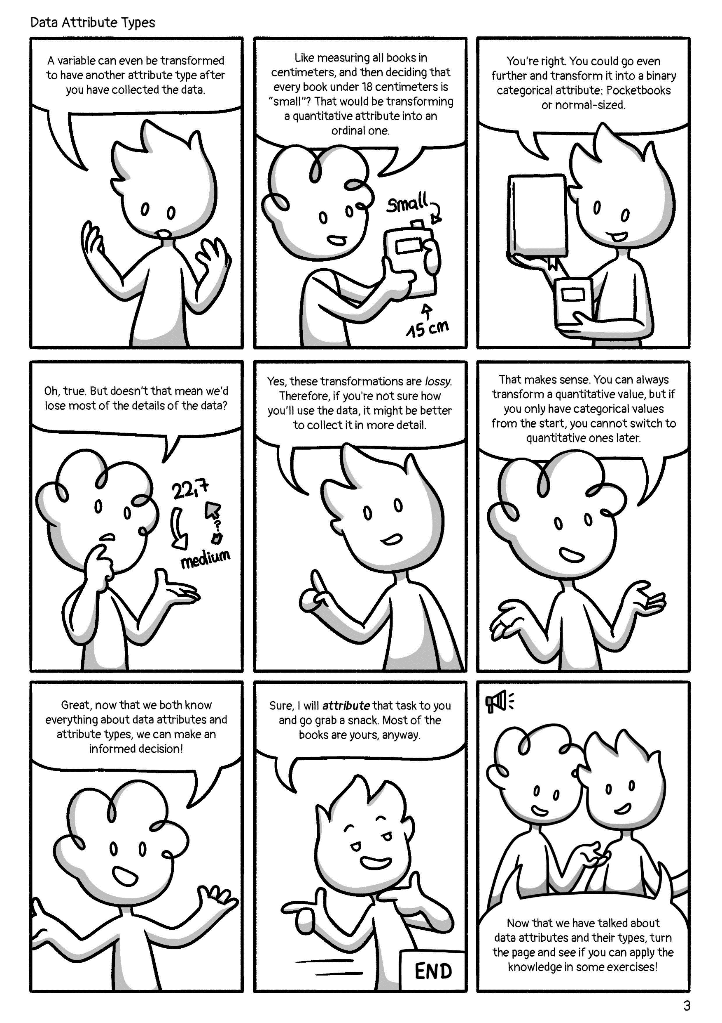
Great, now that we both know everything about data attributes and attribute types, we can make an informed decision!
A variable can even be transformed to have another attribute type after you have collected the data.
Like measuring all books in centimeters, and then deciding that every book under 18 centimeters is “small“? That would be transforming a quantitative attribute into an ordinal one.
You‘re right. You could go even further and transform it into a binary categorical attribute: Pocketbooks or normal-sized.
Oh, true. But doesn‘t that mean we‘d lose most of the details of the data?
Yes, these transformations are lossy. Therefore, if you‘re not sure how you‘ll use the data, it might be better to collect it in more detail.
That makes sense. You can always transform a quantitative value, but if you only have categorical values from the start, you cannot switch to quantitative ones later.
Sure, I will attribute that task to you and go grab a snack. Most of the books are yours, anyway.
Now that we have talked about data attributes and their types, turn the page and see if you can apply the knowledge in some exercises!

Slide 6
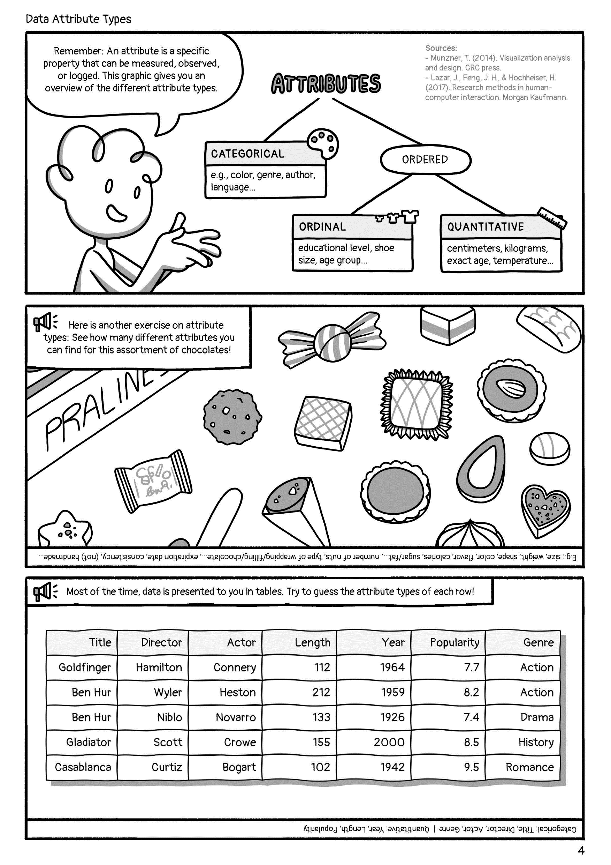
Remember: An attribute is a specific property that can be measured, observed, or logged. This graphic gives you an overview of the different attribute types.
e.g., color, genre, author, language…
educational level, t-shirt size, age group…
centimeters, kilograms, exact age, temperature...
Here is another exercise on attribute types: See how many different attributes you can find for this assortment of chocolates!
Most of the time, data is presented to you in tables. Try to guess the attribute types of each row!

Slide 7

How to cite this document: De-Jesus-Oliveira, V.-A., Boucher, M., Boucher, A., Wu, H.-Y., & Stoiber, C. (2025). Attribute Types. University of Applied Sciences St. Pölten (USTP). https://www.comixplain.cc This comic book was adapted from: Attribute Types © 2023 by Comixplain Team: Victor-Adriel De-Jesus-Oliveira, Hsiang-Yun Wu, Christina Stoiber, Magdalena Boucher, and Alena Ertl, with illustrations by Magdalena Boucher and Alena Ertl, all employed by Sankt Pölten University of Applied Sciences, is licensed under CC BY-SA 4.0.
Sources:
Munzner, T. (2014). Visualization analysis and design. CRC press.
Lazar, J., Feng, J. H., & Hochheiser, H. (2017). Research methods in human-computer interaction. Morgan Kaufmann.

